Slide 1
Regional Defense Partnership for the 21st Century RDP-21: A Catalyst to Partnering with the Military

Slide 2
2025 Fathomwerx Update
Exercises in Safety, Autonomy, and a University Institute
Brendan Applegate, Lead for Fleet Experimentation and Exercises NSWC-PHD
Alan Jaeger, Office of Research and Technology Applications Manager, Percy Hobart Fellow, and Ventura Tech Bridge Director
Jason Miller, Ph.D., Professor of Mathematics at CSUCI
Bill Simmons, Ph.D., NavalX THING

Slide 3
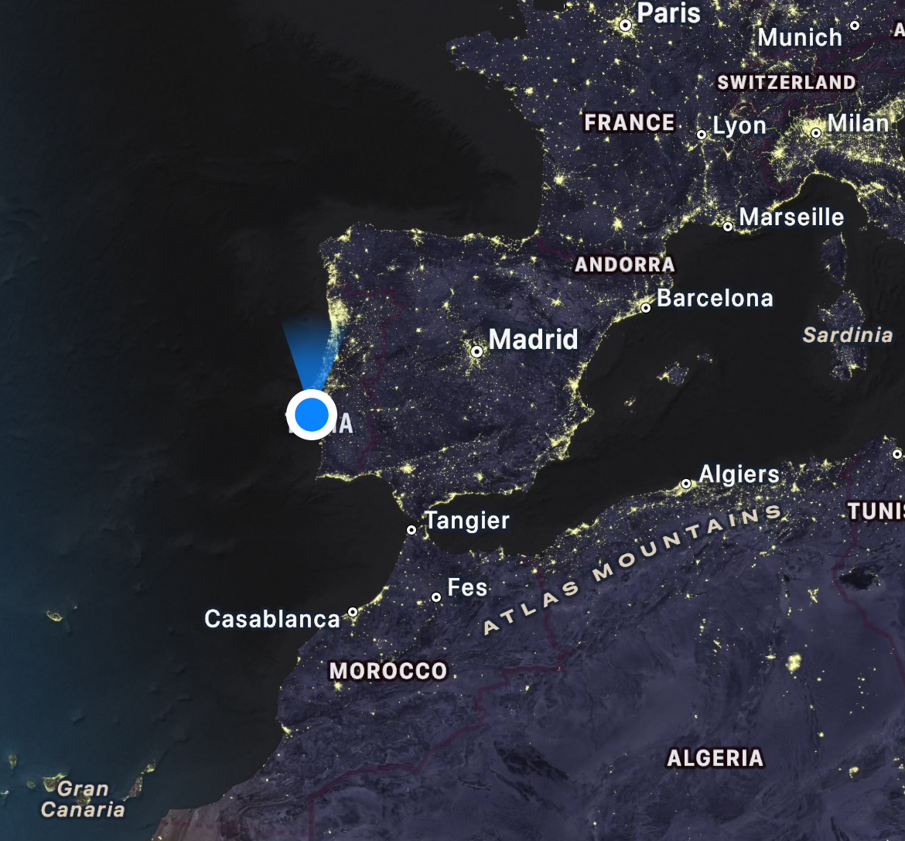

Slide 4
Outline
Fathomwerx
Fathomwerx and Academia
the Institute for Technology and Collaboration
the Navy as catalyst for economic competition
Grey Flag
Autonomous Proving Ground (APG)
Advanced Naval Technology Exercises (ANTX) - Coastal Trident
Technology Free Zone (Portugal REPMUS)
Conclusion

Slide 5
Ventura County Vision
Recognition as a place where the innovation of new technology applications occurs, and Naval Base Ventura County is the engine that powers this regional collaboration.
Strategies:
Continuously innovate military technological capabilities
Use technology partnerships as a catalyst for economic development

Slide 6
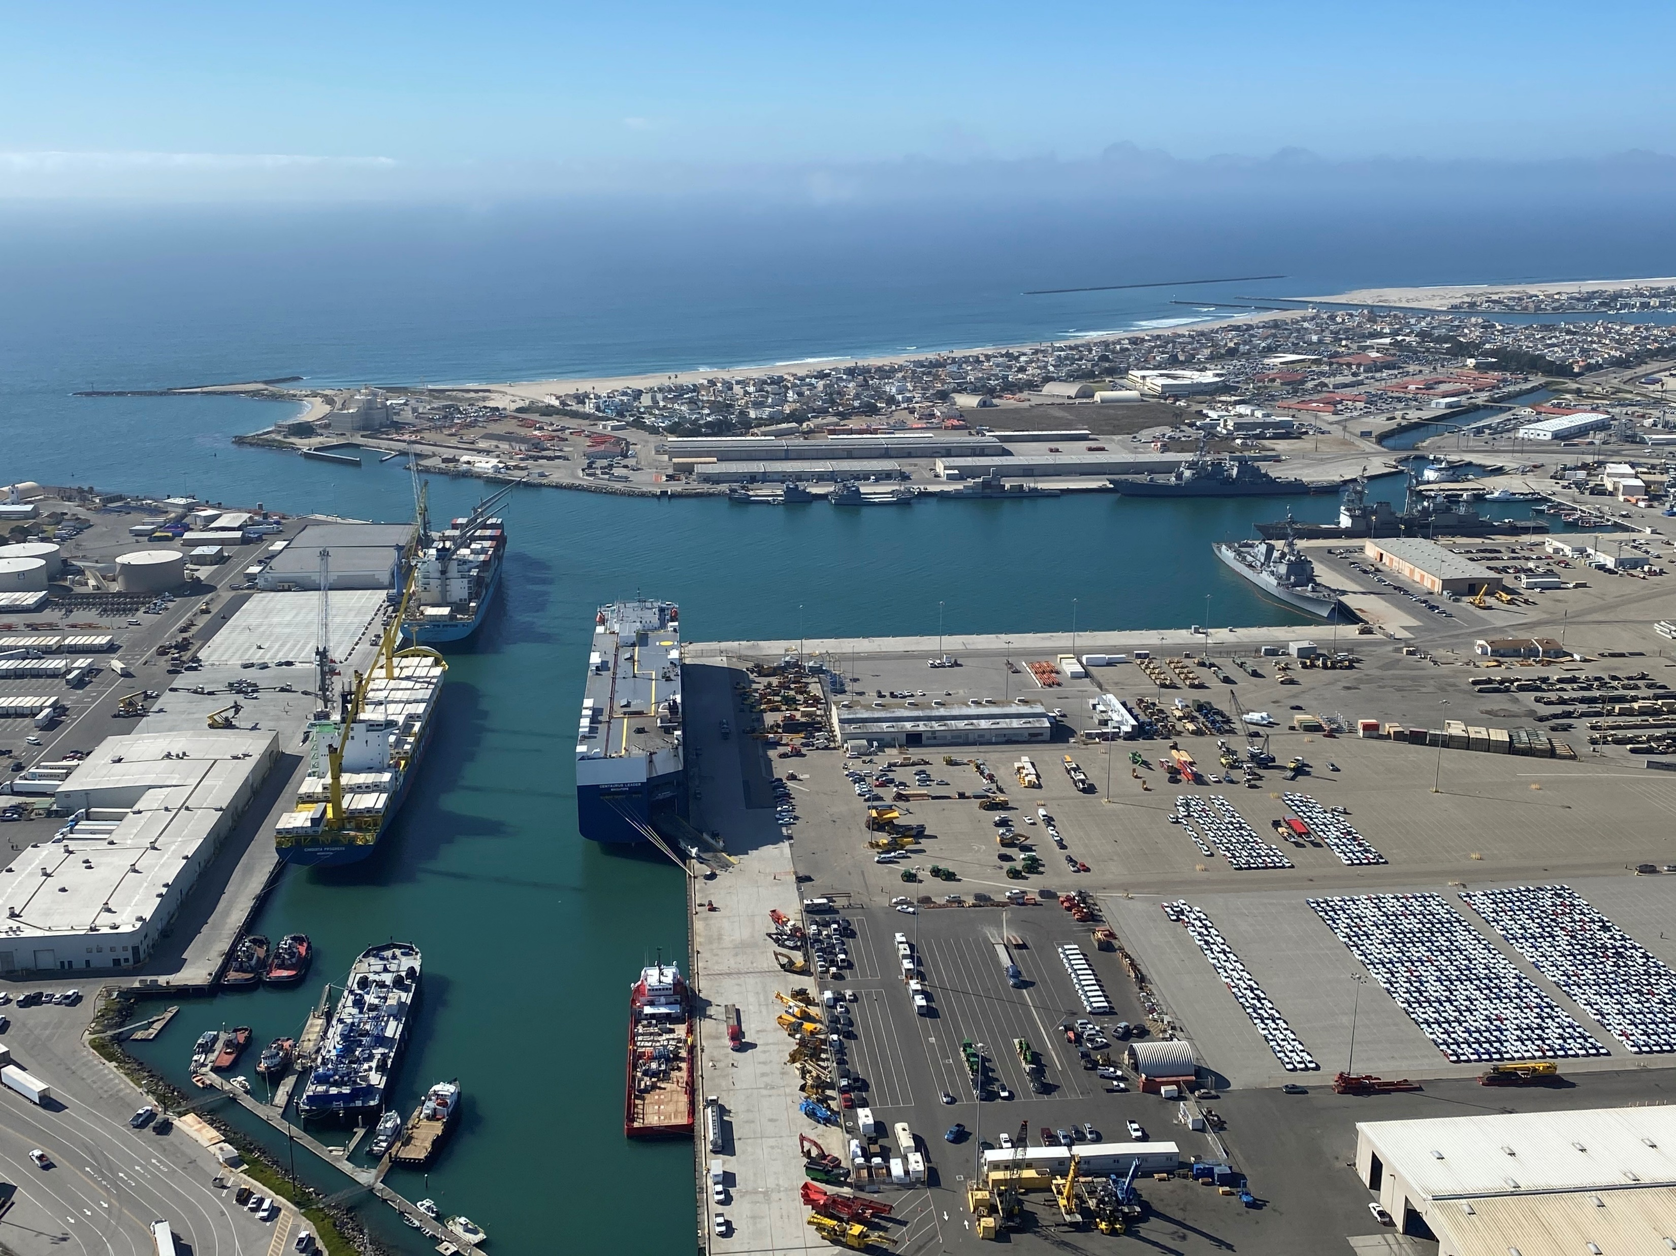
Fathomwerx
Notes:
Image from https://commons.wikimedia.org/wiki/File:Aerial_view_of_Port_Huneme,_California_%28USA%29,_13_December_2020_%28200213-N-GO110-012%29.JPG

Slide 7
Fathomwerx

Slide 8
Fathomwerx Innovation Lab

Slide 9
Fathomwerx Innovation Lab

Slide 10
Fathomwerx
About Us on website: “FATHOMWERX is a technology-based collaborative that includes the EDC, Matterlabs, NAVSEA, NAVFAC, and the Port of Hueneme. Serving as a public-private laboratory, community, and resource for technological innovation, the partners strive to fuse small and non-traditional companies, academic institutions, and other Department of Defense stakeholders together to work on the most challenging problems in military, port, and maritime domains.”

Slide 11
Fathomwerx
About Us on website: “FATHOMWERX is a technology-based collaborative that includes the EDC, Matterlabs, NAVSEA, NAVFAC, and the Port of Hueneme. Serving as a public-private laboratory, community, and resource for technological innovation, the partners strive to fuse small and non-traditional companies, academic institutions, and other Department of Defense stakeholders together to work on the most challenging problems in military, port, and maritime domains.”

Slide 12
Fathomwerx
Fathomwerx does not have a systematic way to engage Academic Institutions in its work
Many professors and students from CSU Channel Islands have participated in Navy programs
ONR Summer Faculty Research Program
ONR Naval Research Enterprise Internship Program (NREIP)
Faculty-mentored undergraduate research in Mechatronics/Robotics
University has legal agreements with the Navy: EPAs and PIAs

Slide 13
Fathomwerx
Fathomwerx does not have a systematic way to engage Academic Institutions in its work
Many professors and students from CSU Channel Islands have participated in Navy programs
ONR Summer Faculty Research Program
ONR Naval Research Enterprise Internship Program (NREIP)
Faculty-mentored undergraduate research in Mechatronics/Robotics
University has legal agreements with the Navy: EPAs and PIAs

Slide 14
Fathomwerx
University has legal agreements with the Navy: EPAs and PIAs
Navy and the University efforts to establish a sustained robust partnership have failed to get traction
Summer 2024: Miller starts a sabbatical at Fathomwerx to study how the organization could build stronger connections with academia

Slide 15
UCF and the Tech Grove

Slide 16
UCF and the Tech Grove
The Tech Grove is a cousin to Fathomwerx’s Ventura Tech Bridge
The Tech Grove (and ‘Team Orlando’) partner with the University of Central Florida
Space
Staff
Programming
A. Jaeger: “Can we do this in Ventura County?”
Sends Seal Team: Rob Heilman, Bill Simmons, Jason Miller

Slide 17
UCF and the Tech Grove
Anecdote: Three guys walk into a VP’s office…
Representative of how difficult it is to get a University to change
(It doesn’t help that these are challenging times for CSU Channel Islands!)
Epiphany: policy of the Academic Senate
After much consultation, Miller proposes an applied research Institute for Technology and Collaboration

Slide 18
Institute for Technology and Collaboration
Goals
Serve as a University clearinghouse for Navy information and opportunities
Entity through which University becomes Fathomwerx’s principle academic partner
Provide Fathomwerx with publicly accessible space on campus for meeting, collaboration, innovation
Promote multi-sector collaboration and innovation that extends Fathomwerx reach into other business sectors

Slide 19
Institute for Technology and Collaboration
Services
Facilitating problem solving meetings between Navy stakeholders and industry solvers
Autonomy
Artificial intelligence
Cybersecurity
Smart ‘cities’ and broadband access
Conduit to other regional academic institutions (e.g., UCSB, SLO)
Publishing white papers promoting regional technology opportunities for growth
Supporting Fathomwerx programming

Slide 20
Institute for Technology and Collaboration
Anecdote: Grey Flag
Annual exercise, systems between U.S. aerial and allied aerial aircraft
In 2024:
75 aircraft
3500 individuals traveling to the region to support created economic Good for the region
“hotel costs were over $800 per night”
These Navy exercises have value to the region
Demonstrate local world-class expertise
“What if those contractors opened shop here?”

Slide 21
Today: Ventura Tech Bridge 2025
ANTX-CT 2025
Participation of 336 organizations at 32 venues in 8 states.
Vandenberg Space Force Base
The Crucible Innovation Cell
(future) Commercial Space Port
Autonomous Systems
Ventura County Airports and Autonomy
Autonomous Proving Grounds

Slide 22
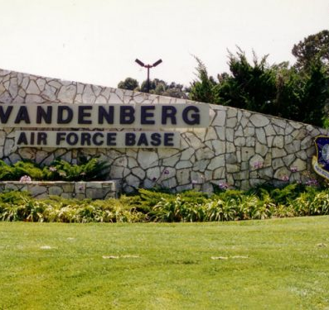
A Bridge to Build in 2025…
Leaders fear that if launches move east, so will most if not all of the R&D and production that now happens in California, creating significant economic vulnerabilities that could cripple California’s current leadership share of the space industry.
U.S. Rep. Salud Carbajal (D-Central Coast), who attended the Hourglass workshop said: “We’ve heard from leaders in technology and space innovation, and we know what they need to thrive in California. Our state has always been on the cutting edge of technology and development—we must be sure we continue taking bold action on job creation and innovation to match. Without a doubt, the excellence of Vandenberg Air Force Base paired with the expertise of Central Coast businesses will create a thriving spaceport. We must ensure they have the resources to stay competitive. I am committed to supporting these efforts and our state’s space leadership in every way I can.”
August 14, 2019
Regional leaders meet to discuss Vandenberg spaceport
Paso Robles Daily News

Slide 23
Autonomous Proving Grounds (APG)
https://www.diu.mil/replicator
“The first iteration of Replicator (Replicator 1), announced in August 2023, will deliver all-domain attritable autonomous systems (ADA2) to warfighters at a scale of multiple thousands, across multiple warfighting domains, within 18-24 months, or by August 2025.”

Slide 24
Autonomous Proving Grounds (APG)
https://www.diu.mil/replicator
“In September 2024, Secretary of Defense Lloyd J. Austin III announced the second iteration of Replicator. Replicator 2 will tackle the warfighter priority of countering the threat posed by small uncrewed aerial systems (C-sUAS) to our most critical installations and force concentrations. Replicator 2 will assist with overcoming challenges we face in the areas of production capacity, technology innovation, authorities, policies, open system architecture and system integration, and force structure.”

Slide 25
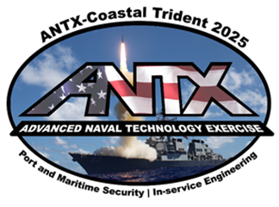
ANTX/Coastal Trident 2025
Planning Phase
Concept Development Meeting November 13, 2024
Request for Initial Project Information November 20, 2024
Project Proposals Due January 8, 2025
Initial Planning Meeting January 15, 2025
Mid-term Planning Meeting March 12, 2025
Final Planning Meeting May 14, 2025
Execution Phase
Field Experiments and Exercises June to September
(dates will be determined by project needs, supporting resources, and technical readiness)
ANTX-Coastal Trident Technology Open House September 23-24, 2025
(in coordination with the annual FATHOMWERX Summit)

Slide 26
[Project Title]
Organization: [organization], [location]
Project Lead: [name], [email], [phone]
[organization logo]
Operational Need:
[describe the problem your project is proposed to address]
System Under Test:
Manufacturer: [manufacturer]
Nomenclature: [system name]
Description: [provide a description of the technology that is the subject of your project]
[photo of system under test]
Project Objective:
[identify what your project is intended to achieve]
Capabilities:
[describe the capabilities provided by the system under test]
Differentiators:
[describe the differences between the system under test and other available systems]
Project Concept of Operations:
[describe the activities that you envision to achieve your project objectives]
Administrative Approvals:
Does your system transmit RF energy (e.g., radio or radar)? [yes or no]
If yes, is it FCC licensed or approved to operate by another authority? [yes or no]
If yes, please provide that documentation along with your project proposal
If no, plan to work with the planning team to provide necessary documentation for authorization to operate, frequency management, safe operating distances
Does your system transmit acoustic energy (e.g., sonar)? [yes or no]
If yes, plan to work with the planning team to obtain necessary approvals to operate in ANTX-CT25 venues
Does your system emit laser radiation (e.g., LiDAR)? [yes or no]
If yes, plan to work with the planning team to obtain necessary approvals to operate in ANTX-CT25 venues
Does your system involve operation of an unmanned aircraft? [yes or no]
If yes, is it a Program of Record or “Blue-UAS Certified?” by DIU? [yes or no]
If no, is it NDAA-compliant for component manufacture? [yes or no]
If yes, plan to work with the planning team to obtain necessary approvals for COTS UAS.
If no, your aircraft may only be operated in a counter-UAS surrogate role
Does your system use lithium batteries? [yes or no]
If yes, plan to work with the planning team to obtain necessary approvals to operate in ANTX-CT25 venues
Resources:
[list the resources you would require from the planning team to support your concept]

Slide 28
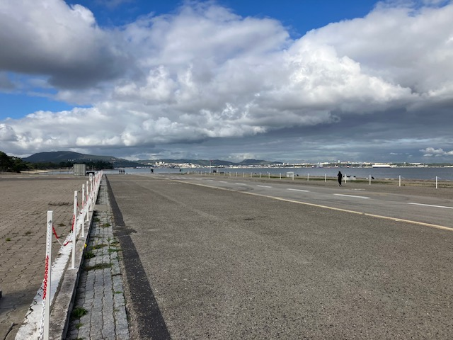
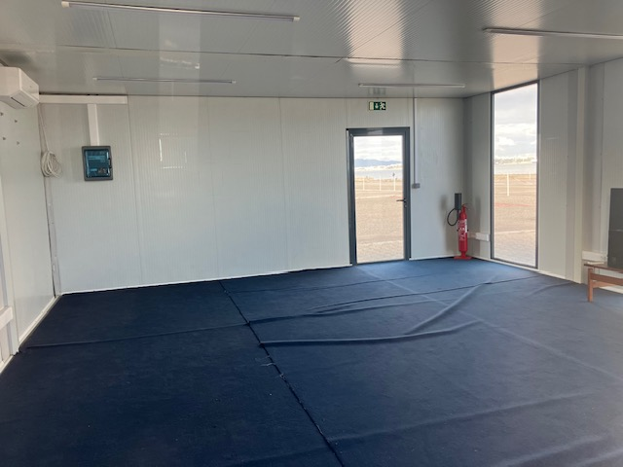
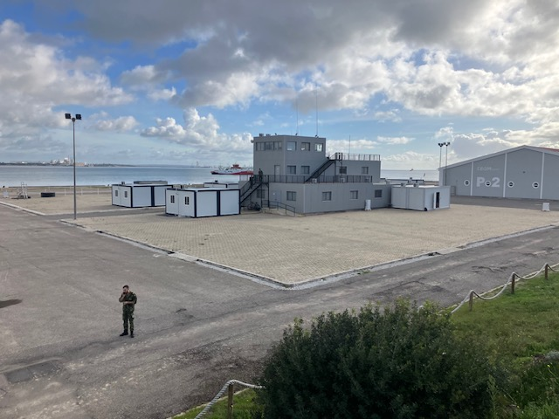
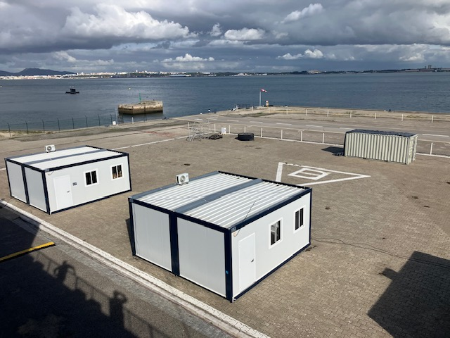
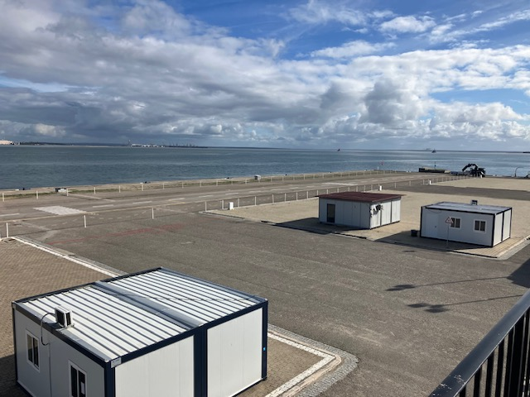
Technology Free Zone
PORTUGAL - Designated airspace, sea space and land areas with preexisting arrangements and agreements for certain types of approvals (FAA, FCC, etc). Then some basic infrastructure that exists that companies can easily use for short durations

Slide 29
Measures of Success
Building Bridges in 2025
Innovation Outcomes
Events
Experiments
Exercises
Economic Development Metrics
Participants
Partnerships
Projects

Slide 30
Questions?
USCG
E/O
NAVAIR
UAS
Cyber
AI
Sensors
RDP-21
FBI
Tech
Consortium
Matter
Labs
ICE
Police
CTM
Sheriff
UUV
EDC
DE
EXWC
NAVSEA
FIRE

